Slide 1


May 2026

Slide 2

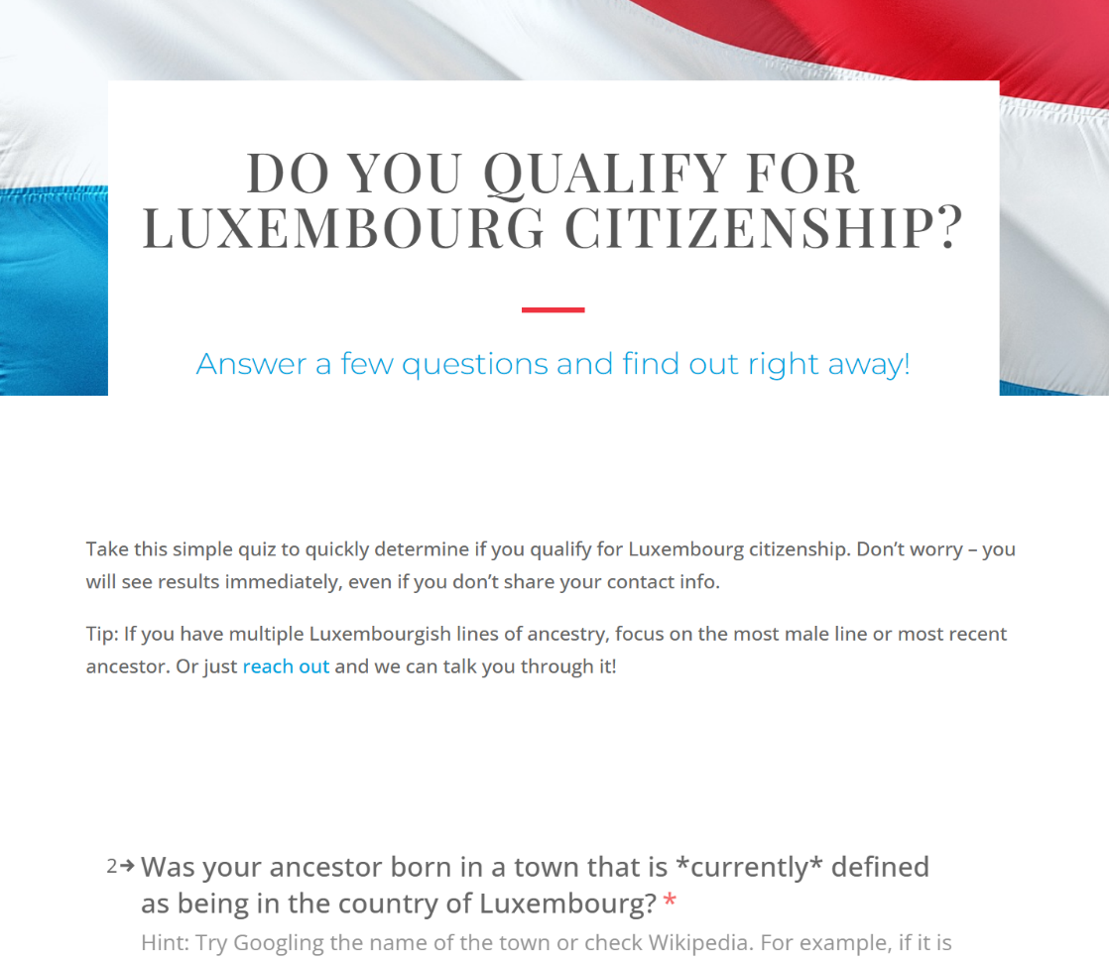
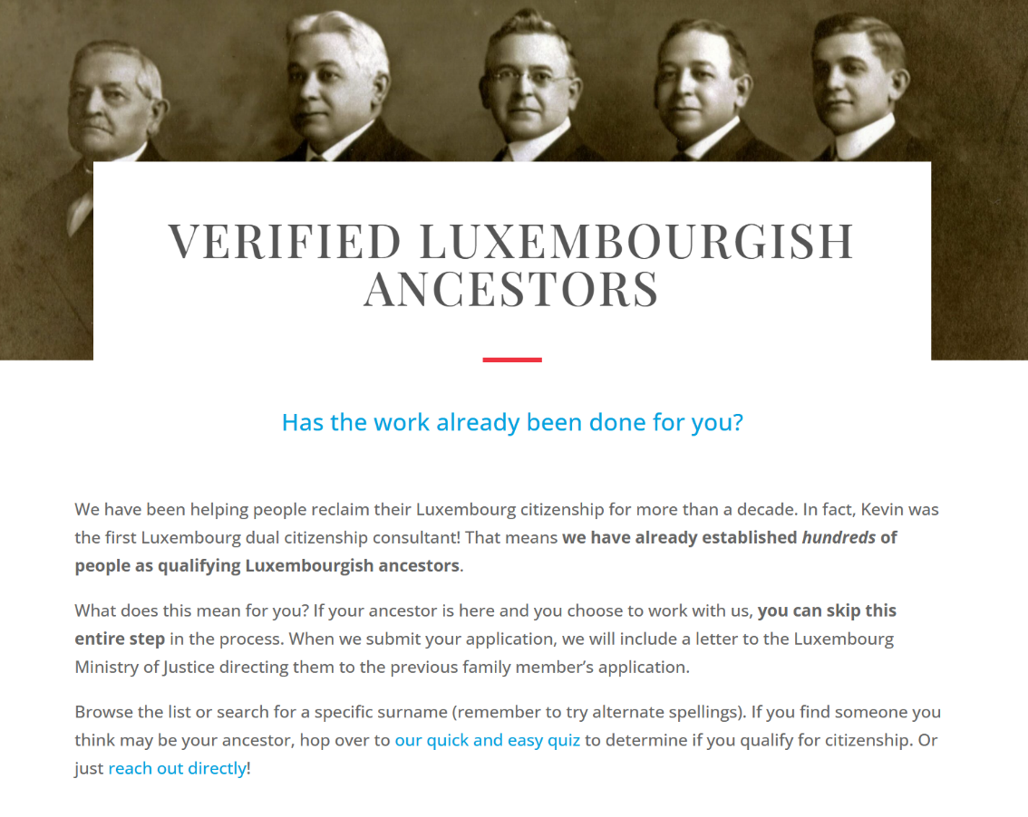
Dual Citizenship with
Luxembourg Legacy

Slide 3

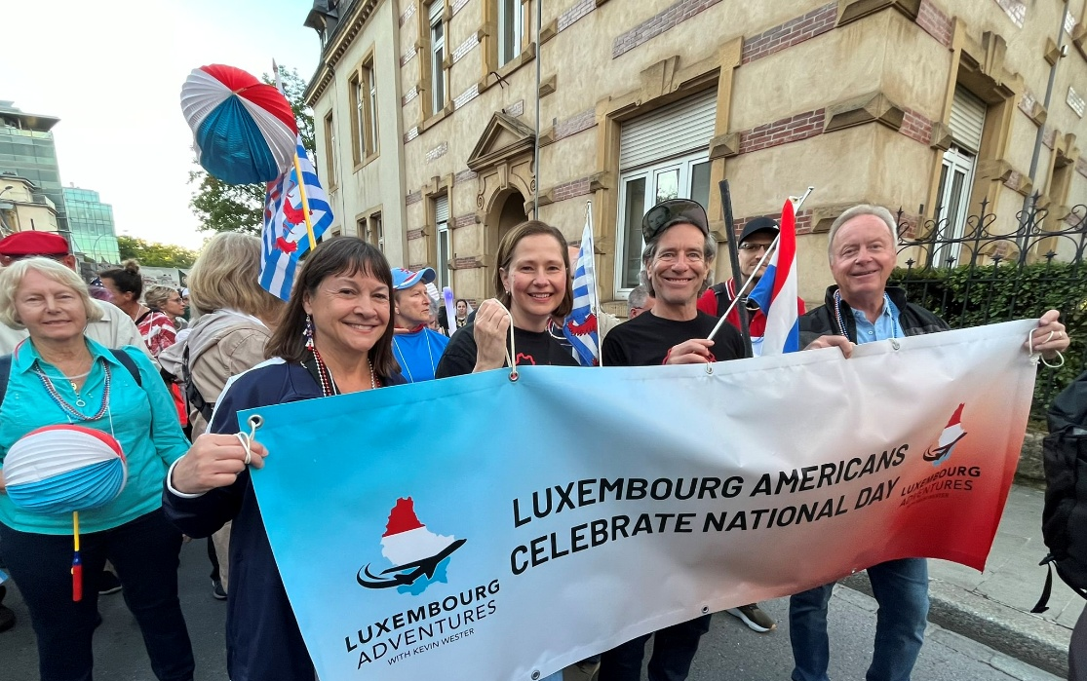
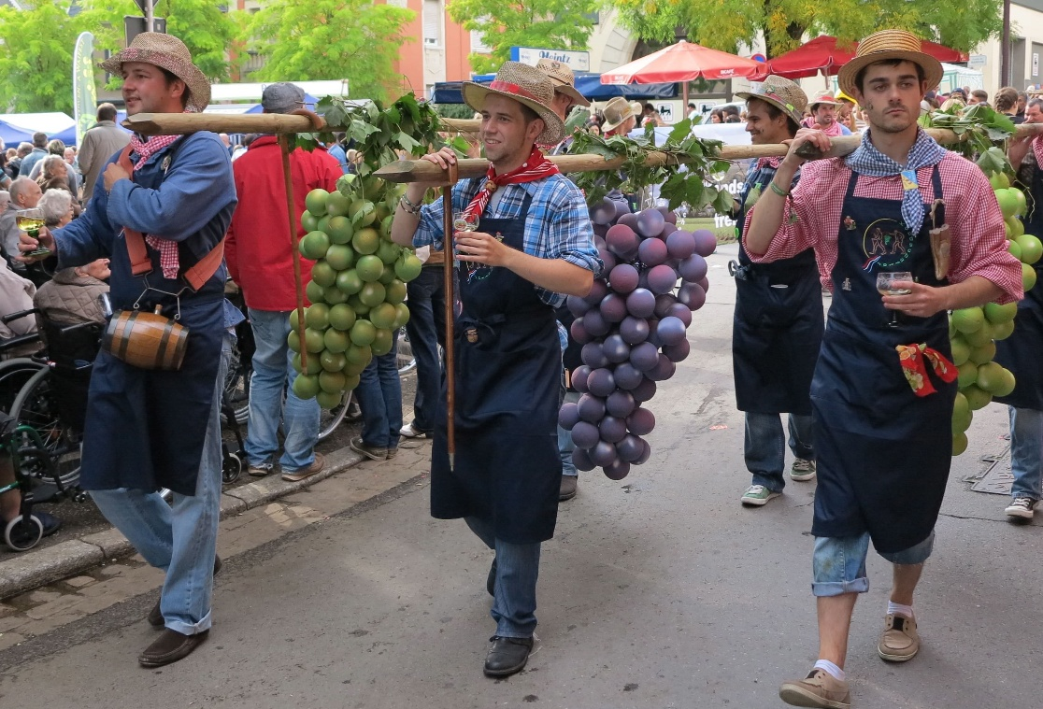
2027 Luxembourg Legacy Tours
National Day
Grevenmacher wine fest
June 16-26, 2027
September 8-18, 2027

Slide 4
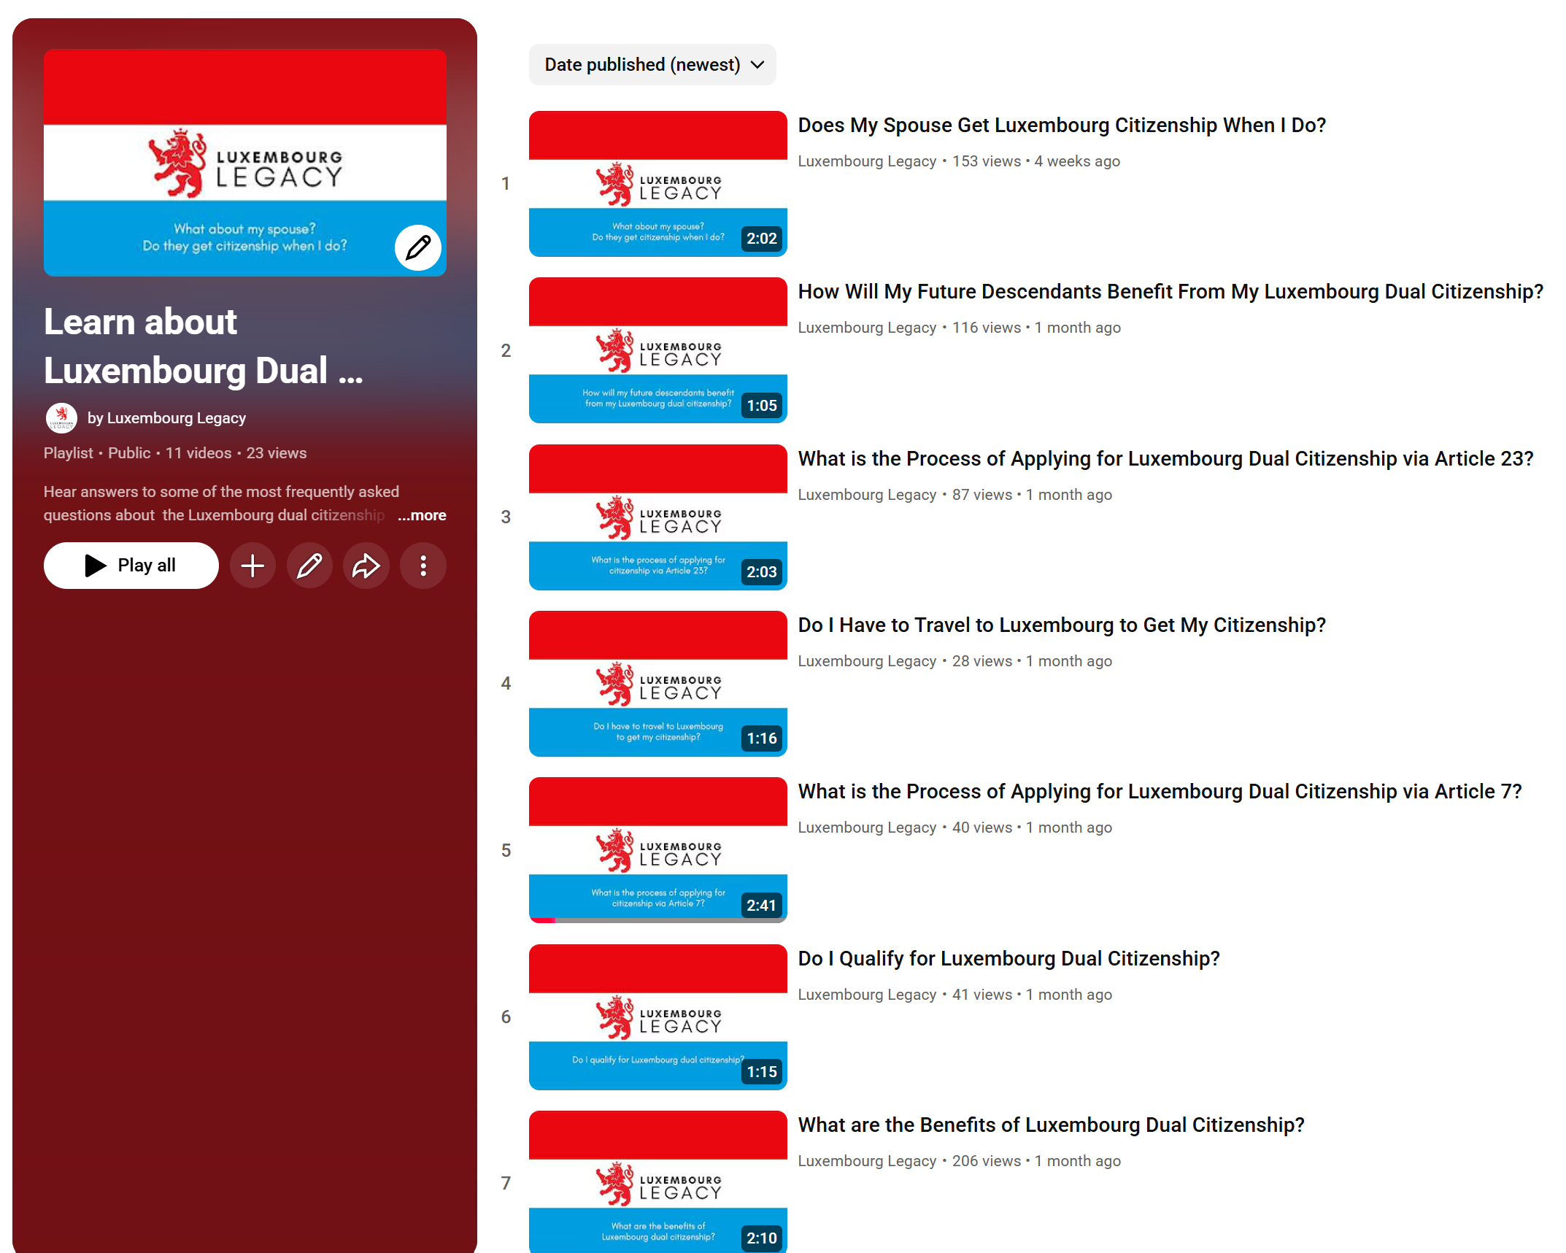
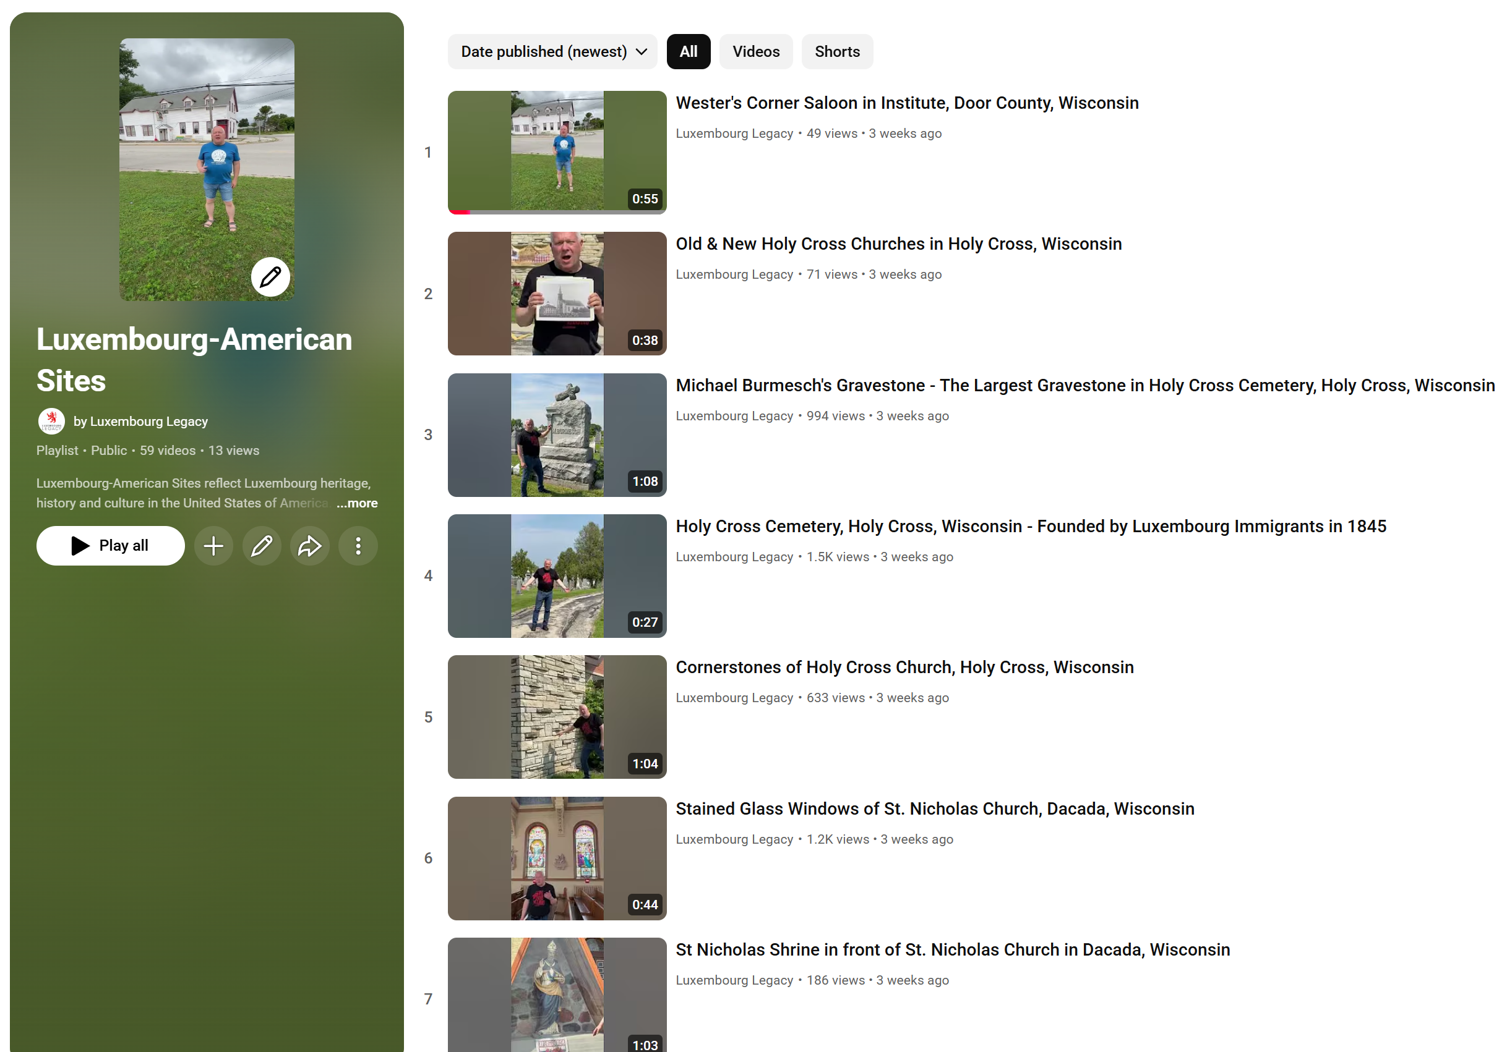
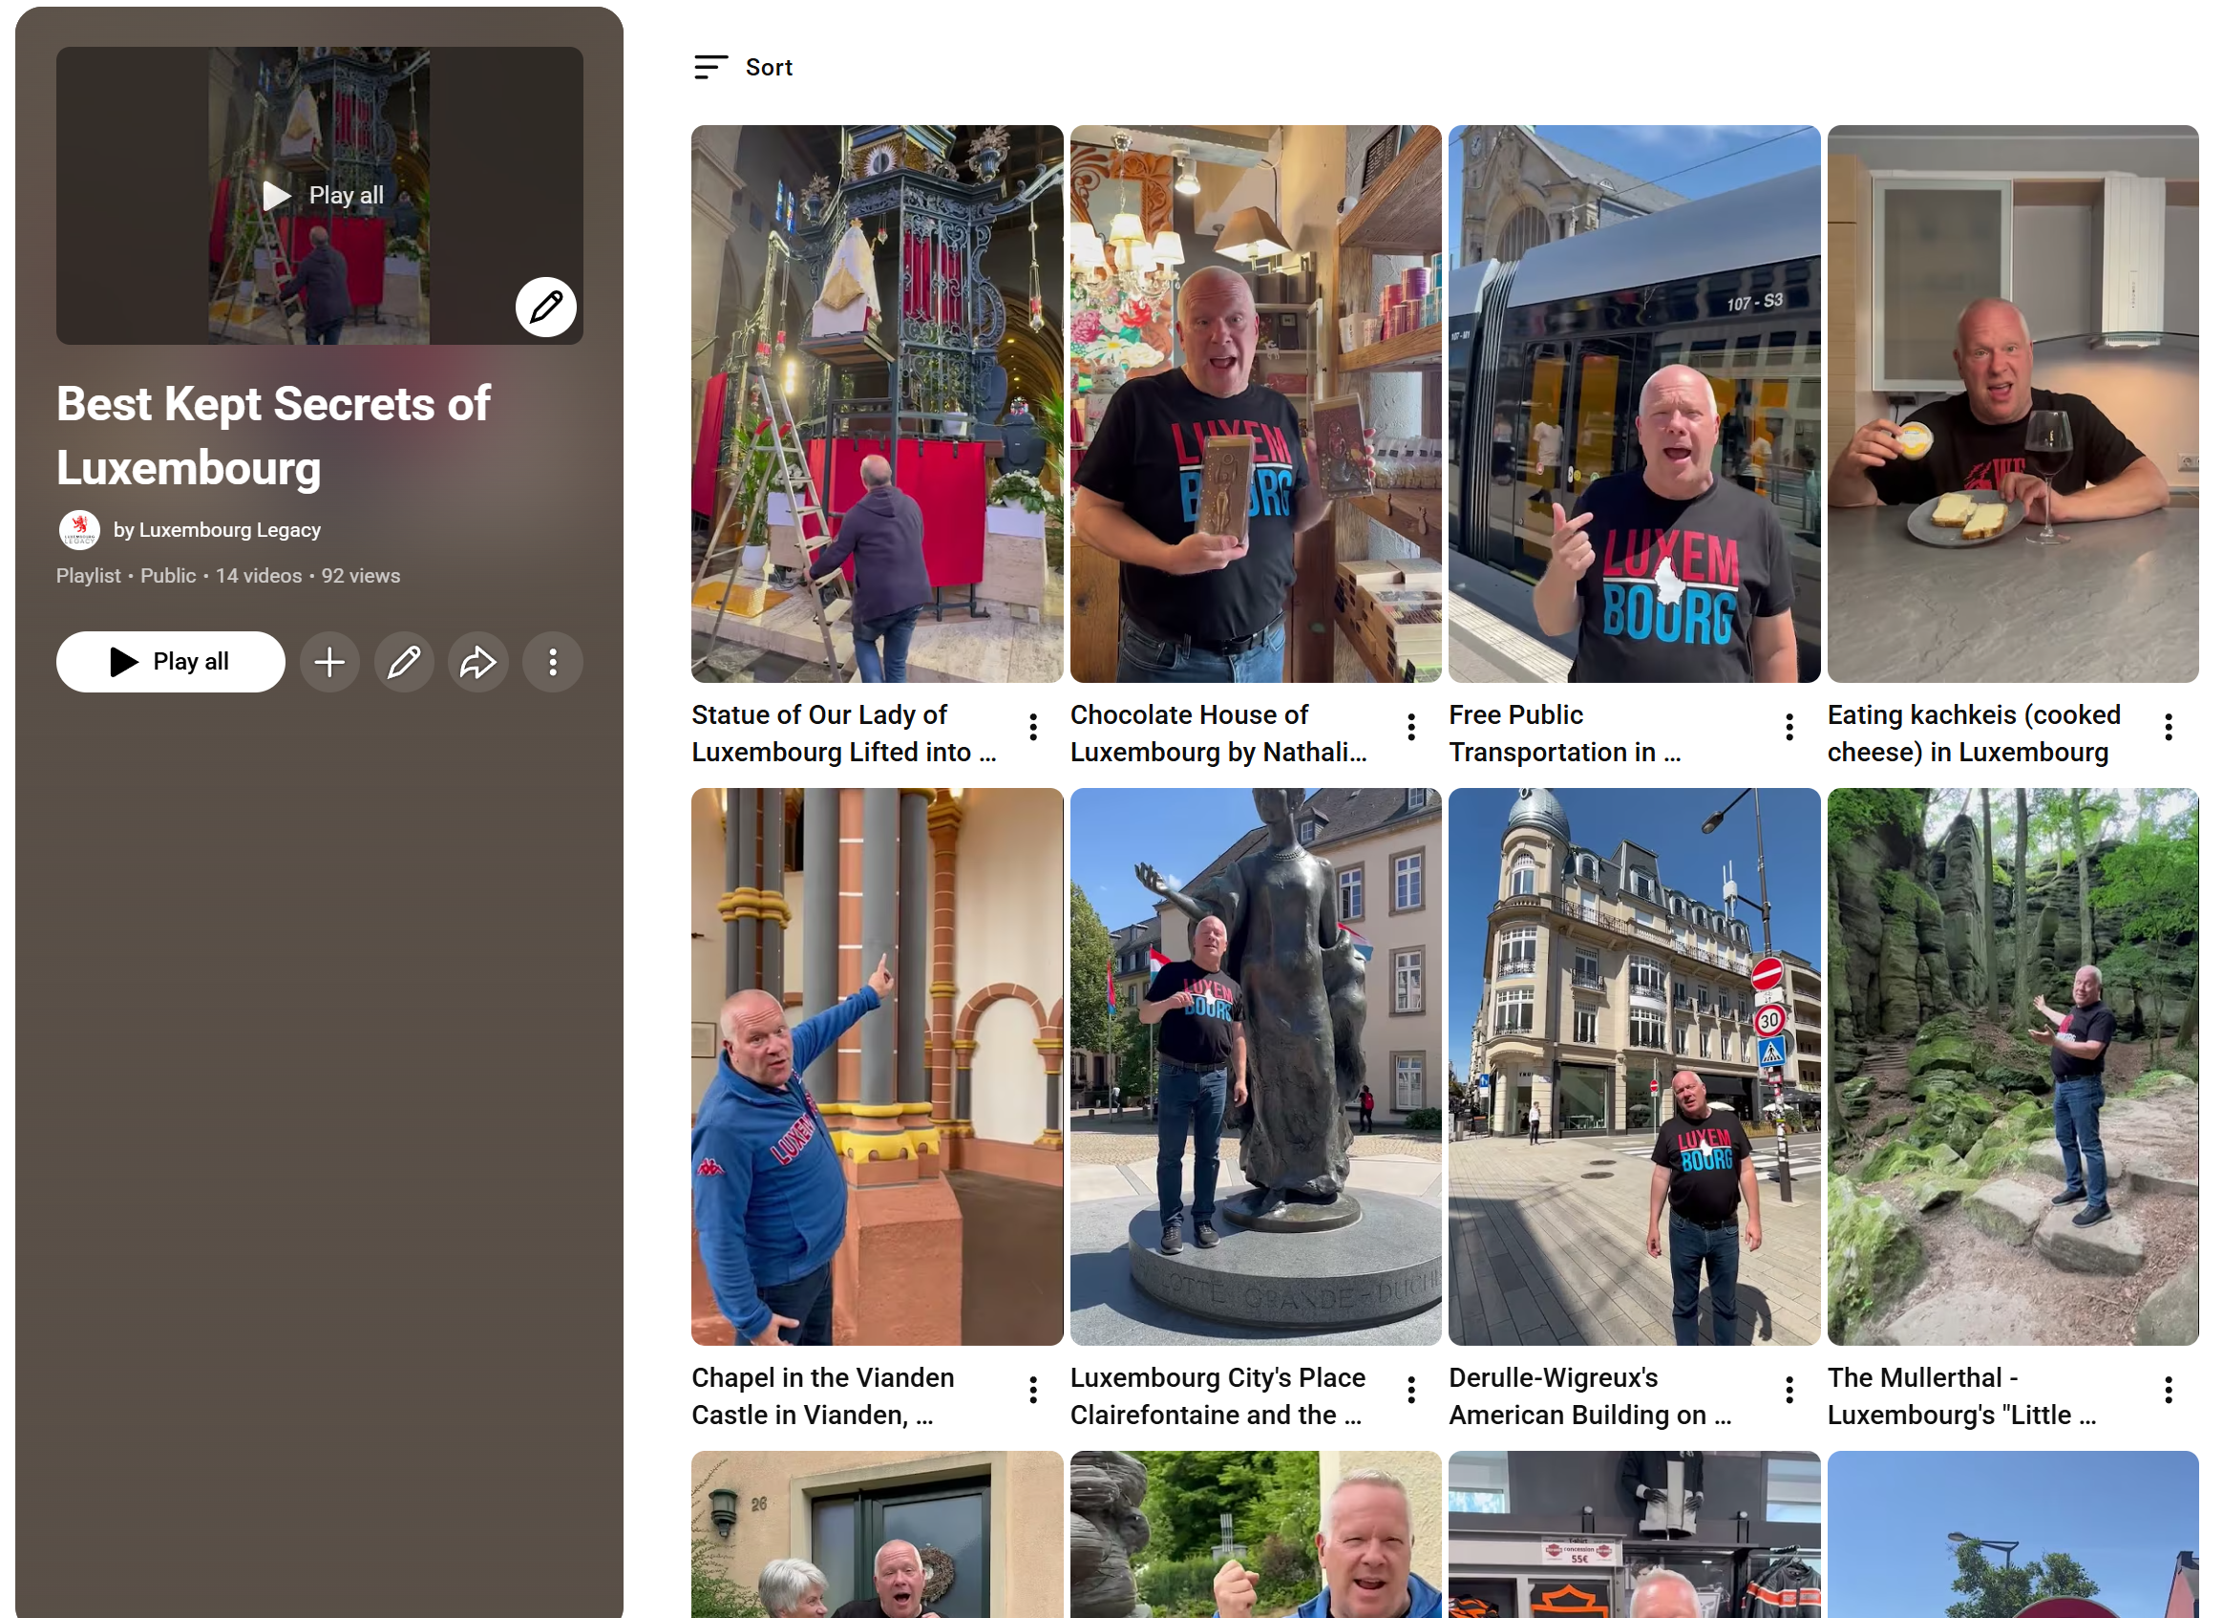
Luxembourg Legacy on YouTube
https://www.youtube.com/@luxembourglegacy

Slide 5
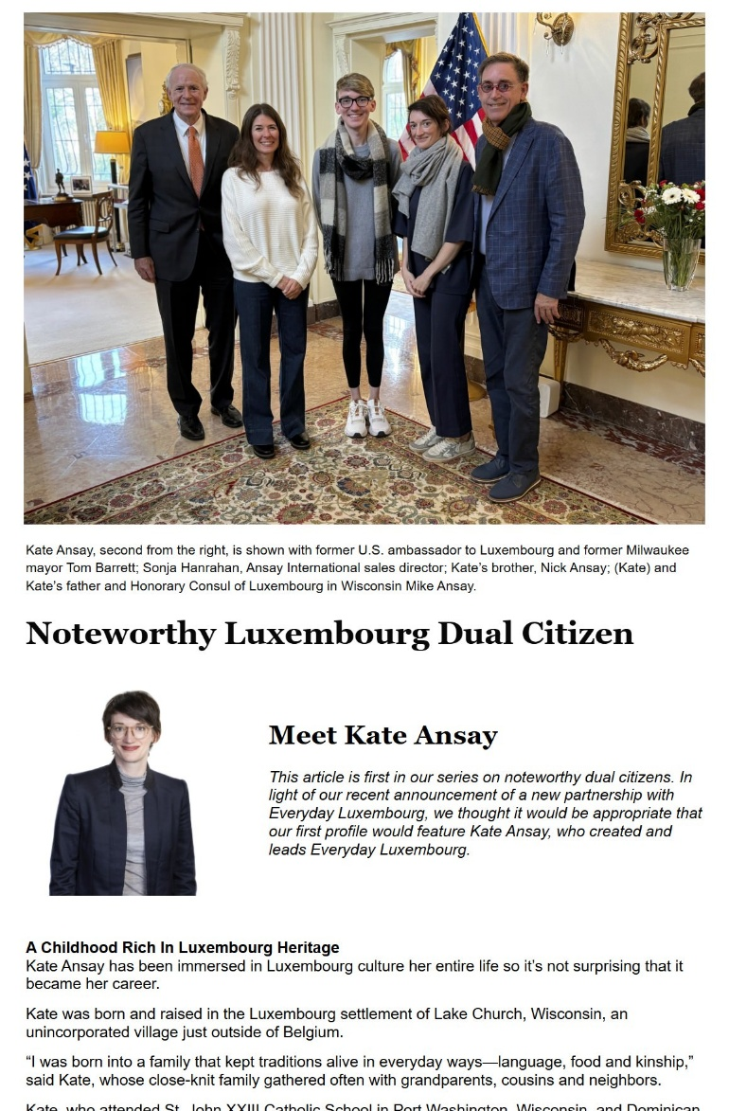
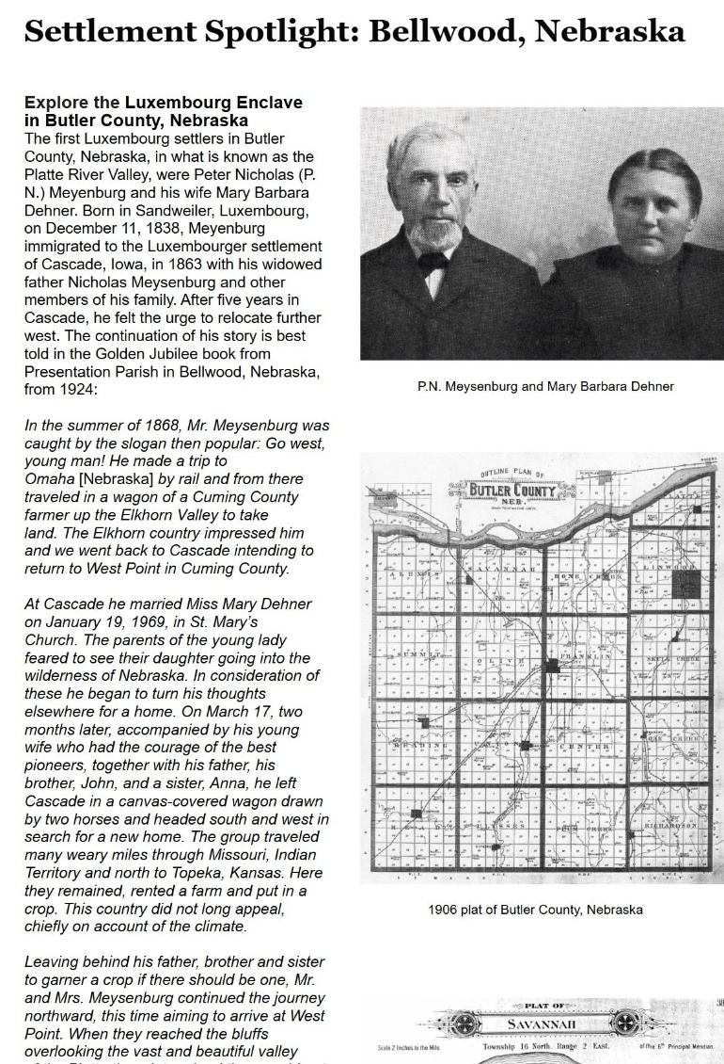

Subscribe to our Mailing List

Slide 6

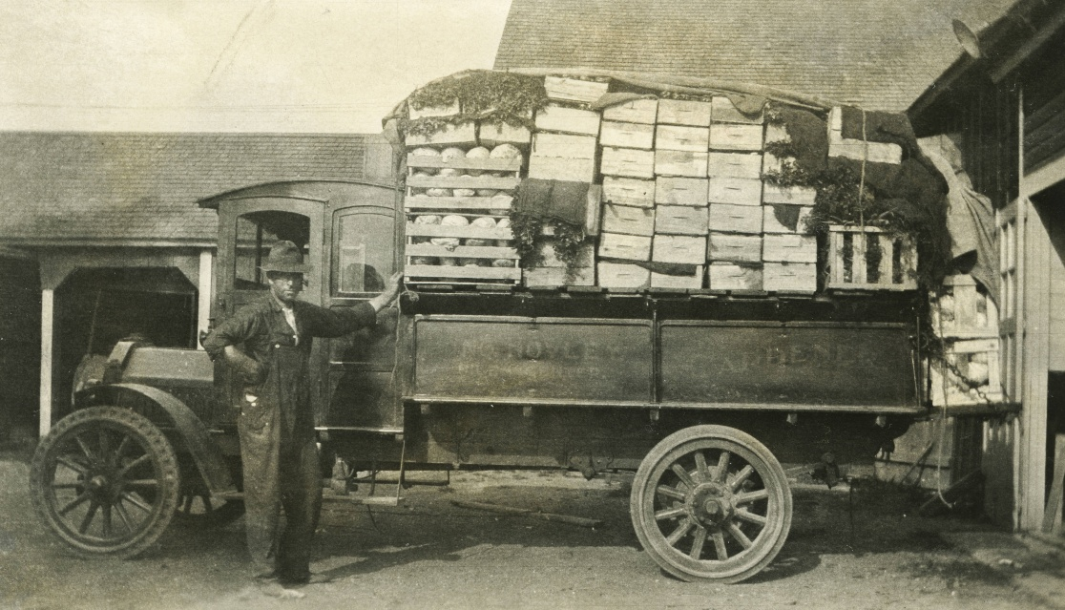
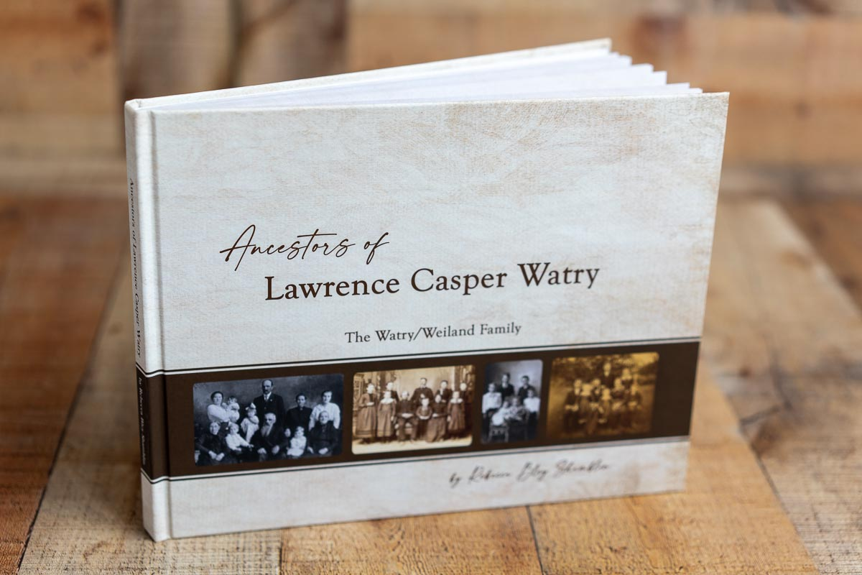
Upcoming Webinars
Luxembourgers
in Chicago
Research Your Luxembourgish Ancestors
KEVIN WESTER
Sunday, Sept. 27
REBECCA SHAMBLIN
Sunday, Nov. 8

Slide 7
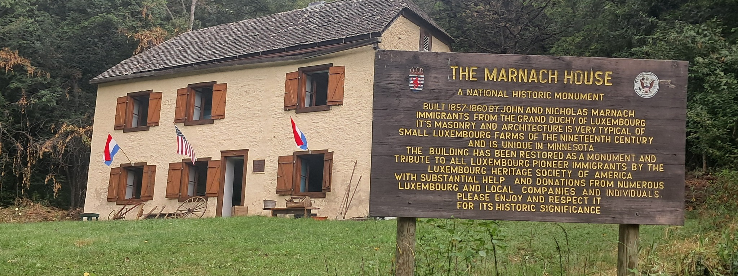
Marnach House
www.eventbrite.com/e/luxembourg-minnesota-history-celebration-a-marnach-house-fundraiser-tickets-1983479943906
Luxembourg Heritage Society of Elba MN
15708 Larson Road, Altura, MN 55910

Slide 8

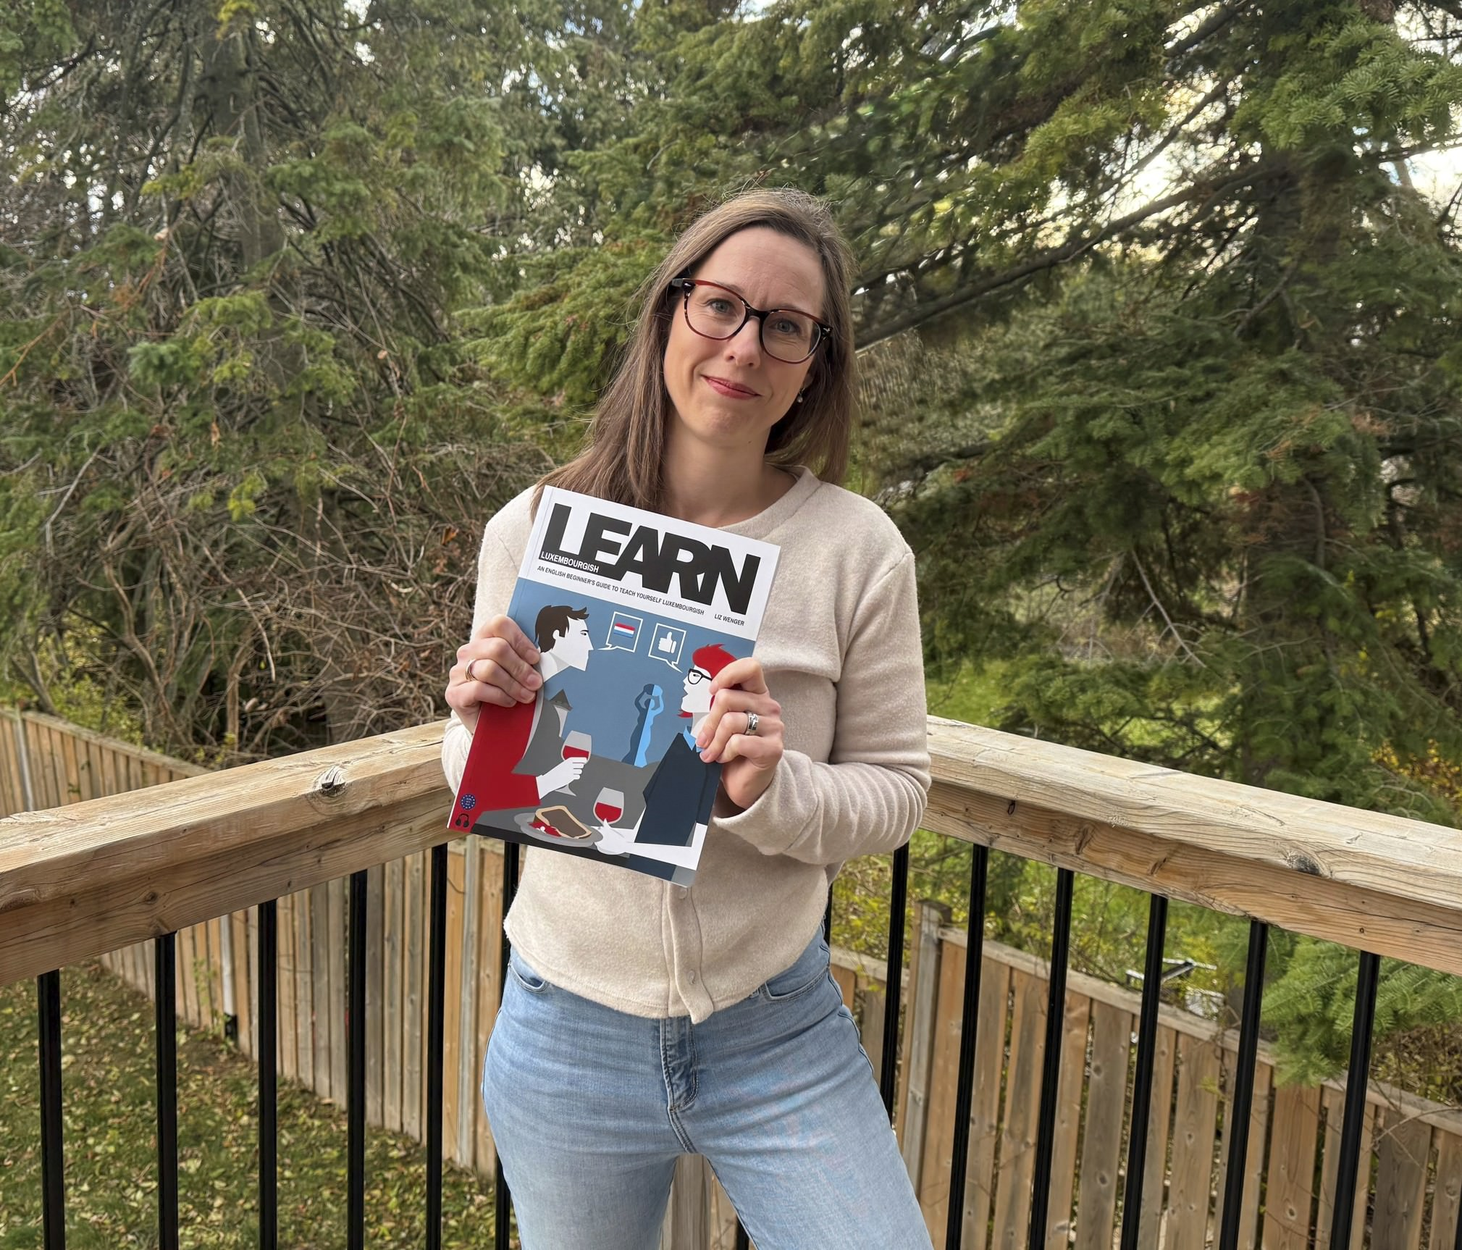
Liz Wenger

